Slide 1
SE301: Numerical Methods
Topic 8
Ordinary Differential Equations (ODEs)
Lecture 28-36
KFUPM
(Term 101)
Section 04
Read 25.1-25.4, 26-2, 27-1
CISE301_Topic8L3

Slide 2
Outline of Topic 8
Lesson 1: Introduction to ODEs
Lesson 2: Taylor series methods
Lesson 3: Midpoint and Heun’s method
Lessons 4-5: Runge-Kutta methods
Lesson 6: Solving systems of ODEs
Lesson 7: Multiple step Methods
Lesson 8-9: Boundary value Problems
CISE301_Topic8L3

Slide 3
Lecture 30
Lesson 3: Midpoint and Heun’s Predictor Corrector Methods
CISE301_Topic8L3

Slide 4
Learning Objectives of Lesson 3
To be able to solve first order differential equations using the Midpoint Method.
To be able to solve first order differential equations using the Heun’s Predictor Corrector Method.
CISE301_Topic8L3

Slide 5
Topic 8: Lesson 3
Lesson 3: Midpoint and Heun’s
Predictor-Corrector Methods
  Review Euler Method
  Heun’s Method
  Midpoint Method
CISE301_Topic8L3

Slide 6
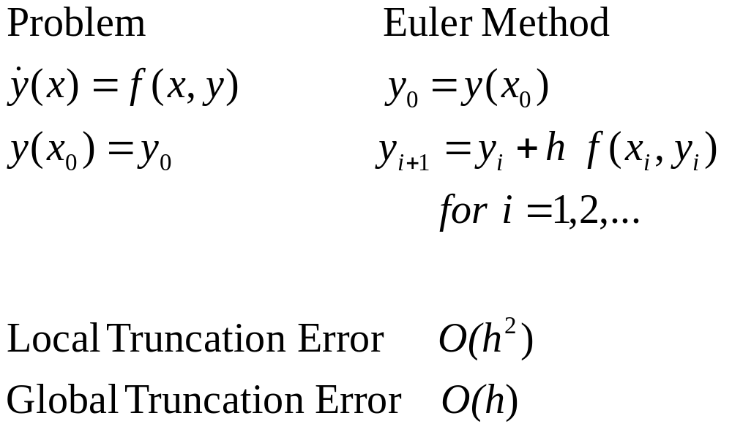
Euler Method
CISE301_Topic8L3

Slide 7
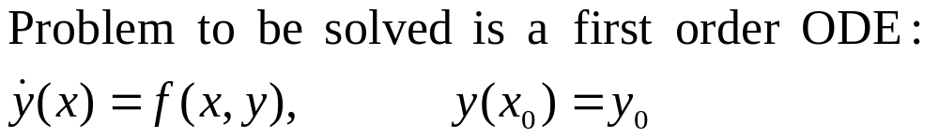
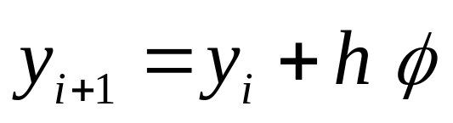
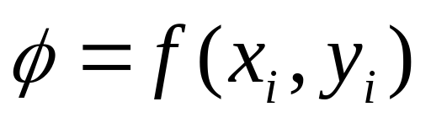

Introduction
The methods proposed in this lesson have the general form:
For the case of Euler:
Different forms of will be used for the Midpoint and Heun’s Methods.
CISE301_Topic8L3

Slide 8
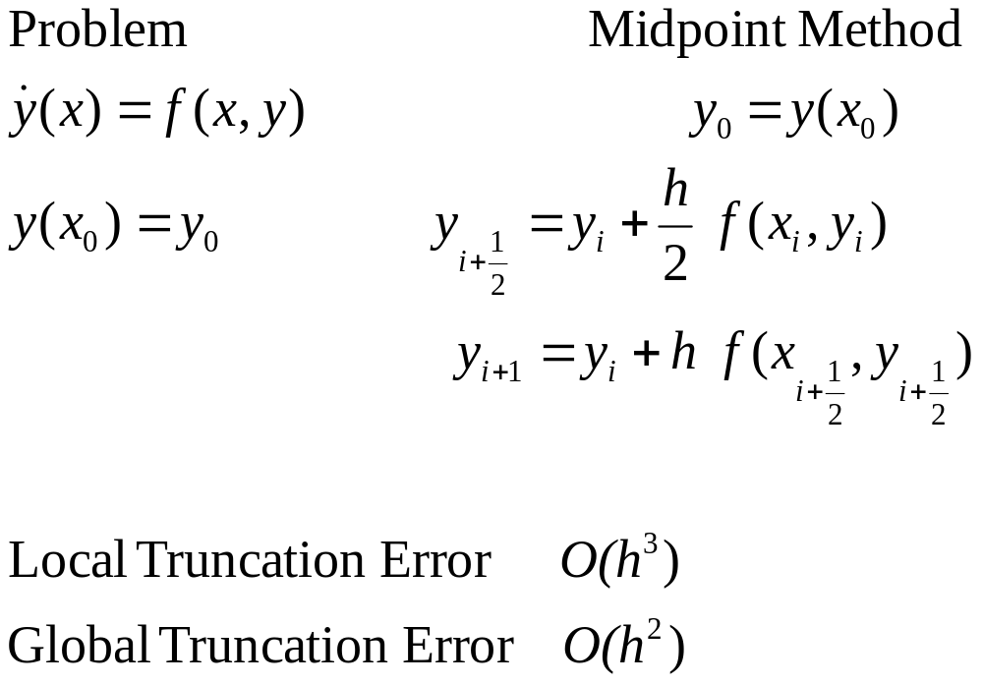
Midpoint Method
CISE301_Topic8L3

Slide 9
Motivation
The midpoint can be summarized as:
  Euler method is used to estimate the solution at the midpoint.
  The value of the rate function f(x,y) at the mid point is calculated.
  This value is used to estimate y_{i+1}.
Local Truncation error of order O(h³).
Comparable to Second order Taylor series method.
CISE301_Topic8L3

Slide 10
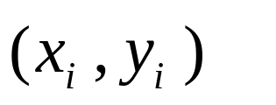
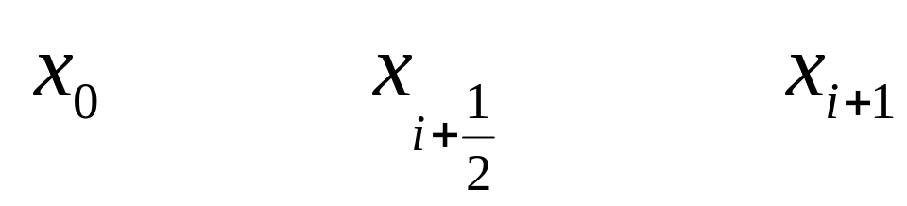
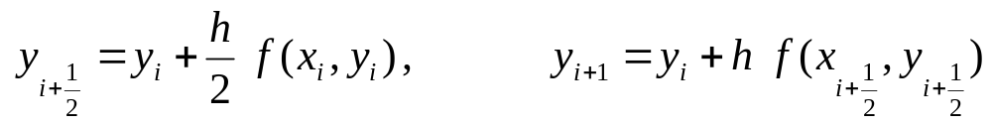
Midpoint Method
CISE301_Topic8L3

Slide 11
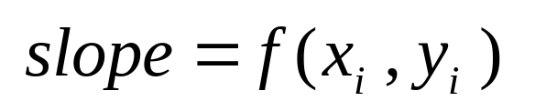
Midpoint Method
CISE301_Topic8L3

Slide 12
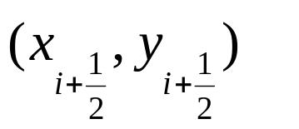
Midpoint Method
CISE301_Topic8L3

Slide 13
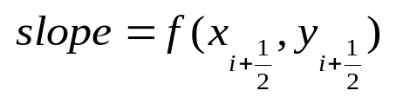
Midpoint Method
CISE301_Topic8L3

Slide 14

Midpoint Method
CISE301_Topic8L3

Slide 15
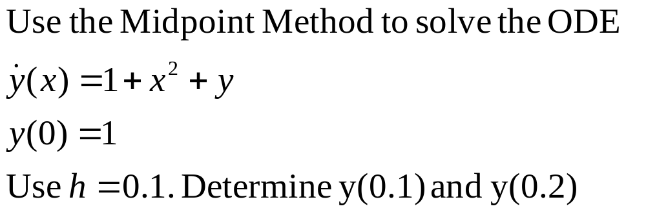
Example 1
CISE301_Topic8L3

Slide 16
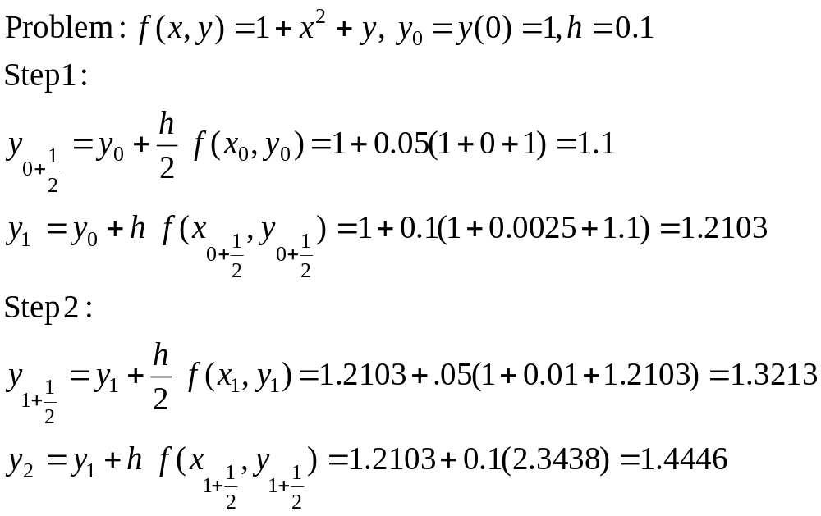
Example 1
CISE301_Topic8L3

Slide 17
Heun’s Predictor Corrector
CISE301_Topic8L3

Slide 18
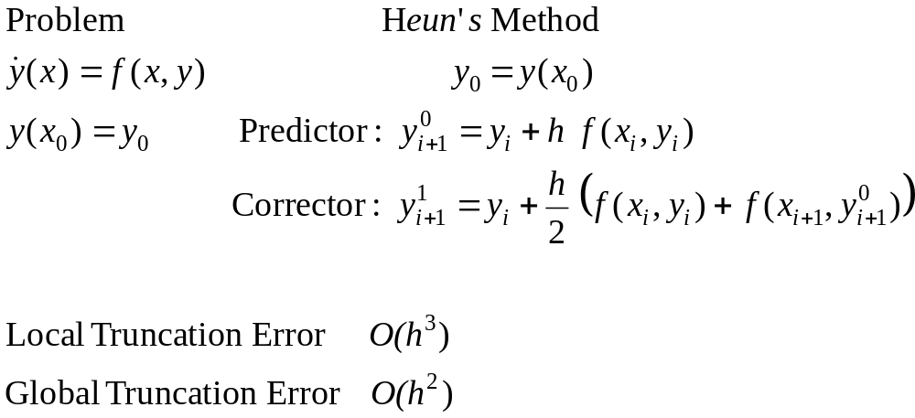
Heun’s Predictor Corrector Method
CISE301_Topic8L3

Slide 19
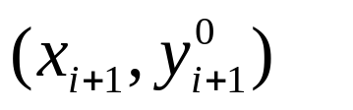
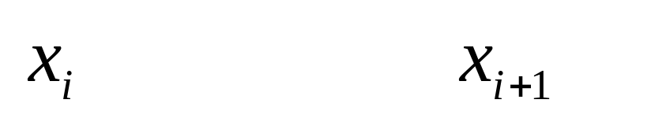
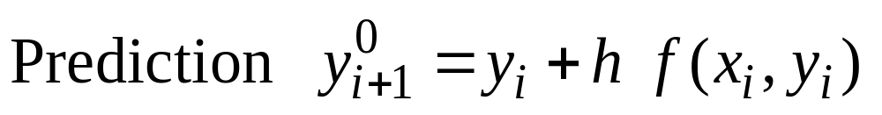
Heun’s Predictor Corrector
(Prediction)
CISE301_Topic8L3

Slide 20
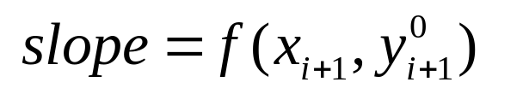
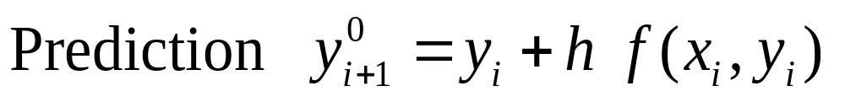
Heun’s Predictor Corrector
(Prediction)
CISE301_Topic8L3

Slide 21
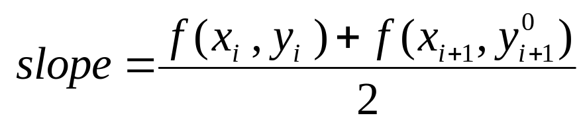
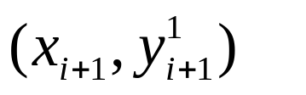
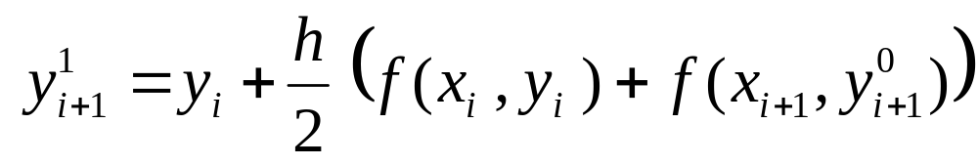
Heun’s Predictor Corrector
(Correction)
CISE301_Topic8L3

Slide 22
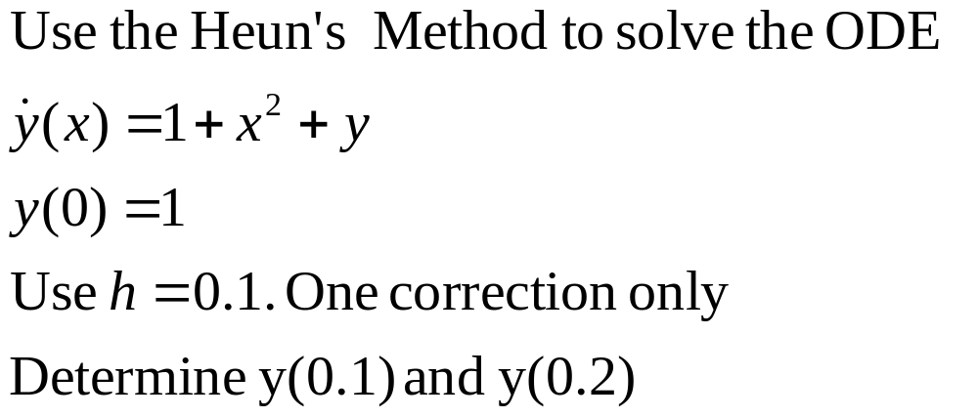
Example 2
CISE301_Topic8L3

Slide 23
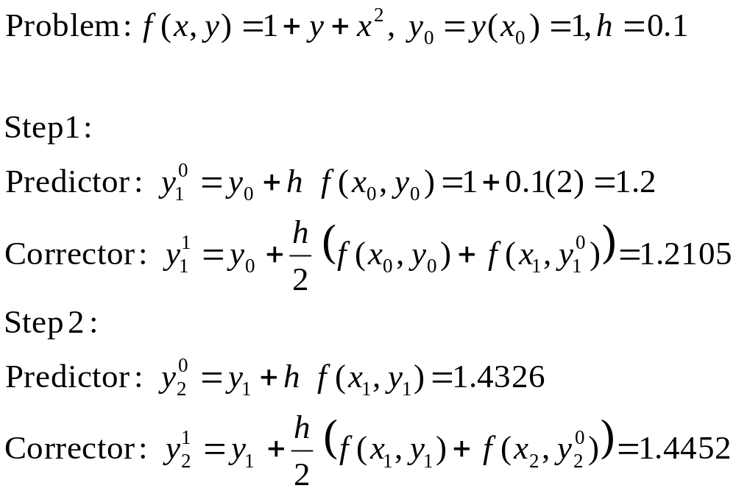
Example 2
CISE301_Topic8L3

Slide 24
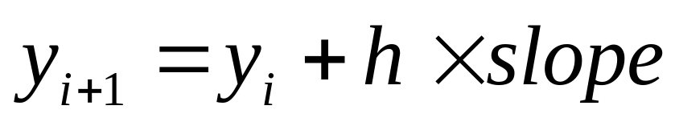
Summary
Euler, Midpoint and Heun’s methods are similar in the following sense:
  Different methods use different estimates of the slope.
Both Midpoint and Heun’s methods are comparable in accuracy to the second order Taylor series method.
CISE301_Topic8L3

Slide 25
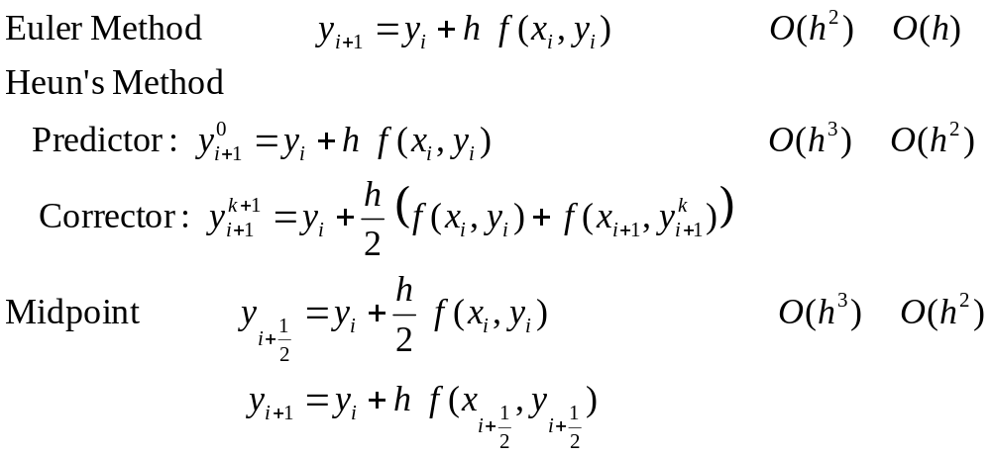
Comparison
Method | Local truncation error | Global truncation error
CISE301_Topic8L3

Slide 26
More in this Topic
Lessons 4-5: Runge-Kutta Methods
Lesson 6: Systems of High order ODE
Lesson 7: Multi-step methods
Lessons 8-9: Boundary Value Problems
CISE301_Topic8L3

